Slide 1
EE150 Tutorial 11
Sampling

Slide 2
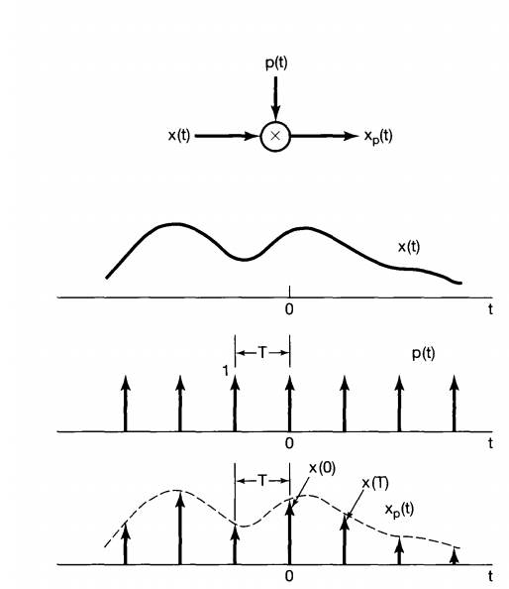


Time domain
In time domain, the signal is periodically sampled

Slide 3
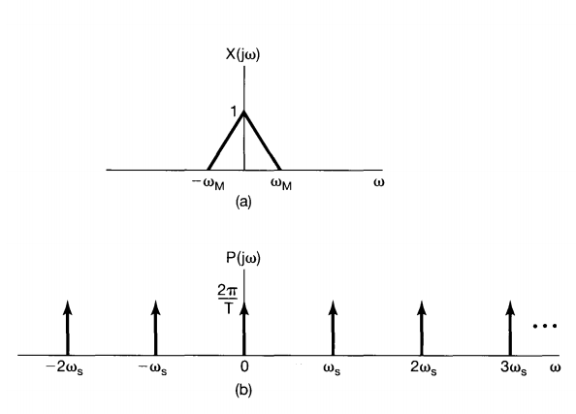

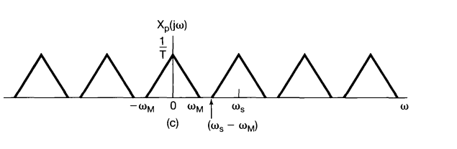

Frequency domain
In frequency domain, the spectrum is periodic extended with amplitude changed

Slide 4
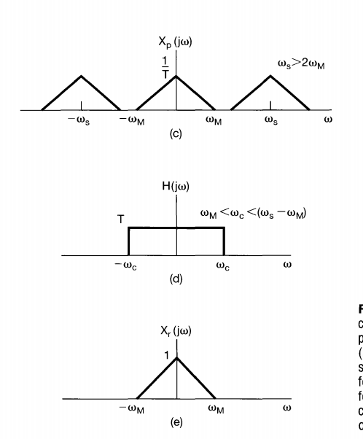

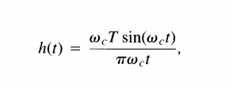
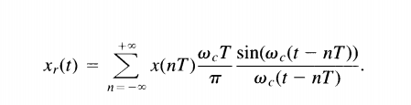
Reconstruction (ideal)

Slide 5
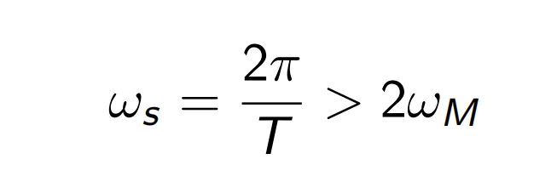
Nyquist sampling rate
To sample the band-limited signal without lossing information
To reconstruct the original signal
The minimum sampling frequency required

Slide 6
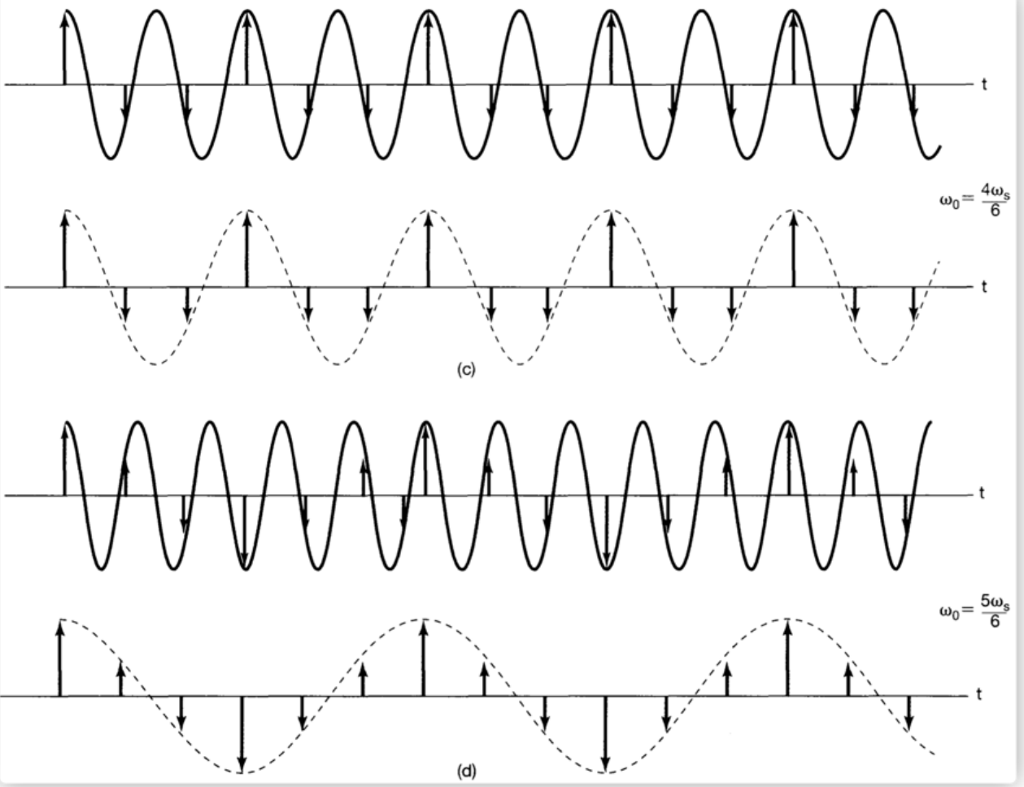
Aliasing
From the view of time domain , why sampling theorm holds?
In (c), the 2nd sampling point (-0.5) is the second time the signal reaching -0.5
The construction takes it as the first time.
So the latest 2nd sampling to avoid aliasing is -1.

Slide 7
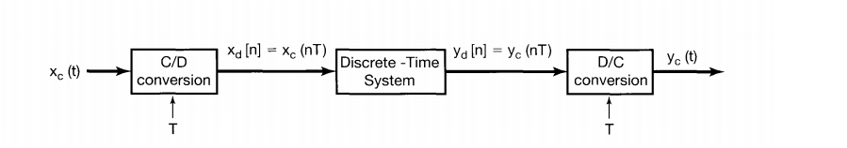
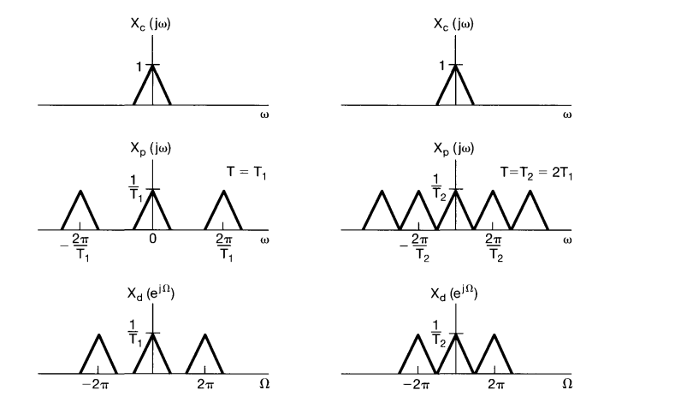
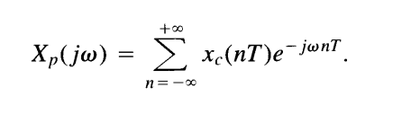
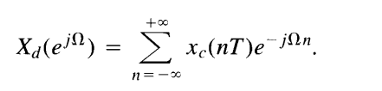
Discrete processing of CT signals

Slide 8
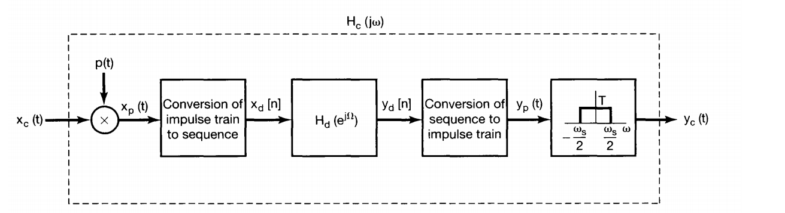
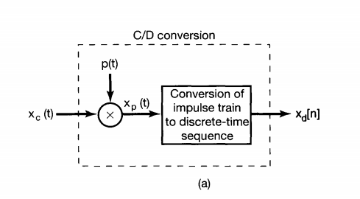
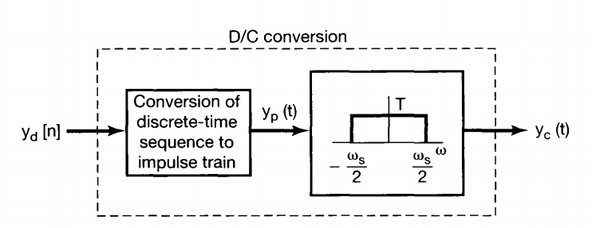
Discrete processing of CT signals

Slide 9
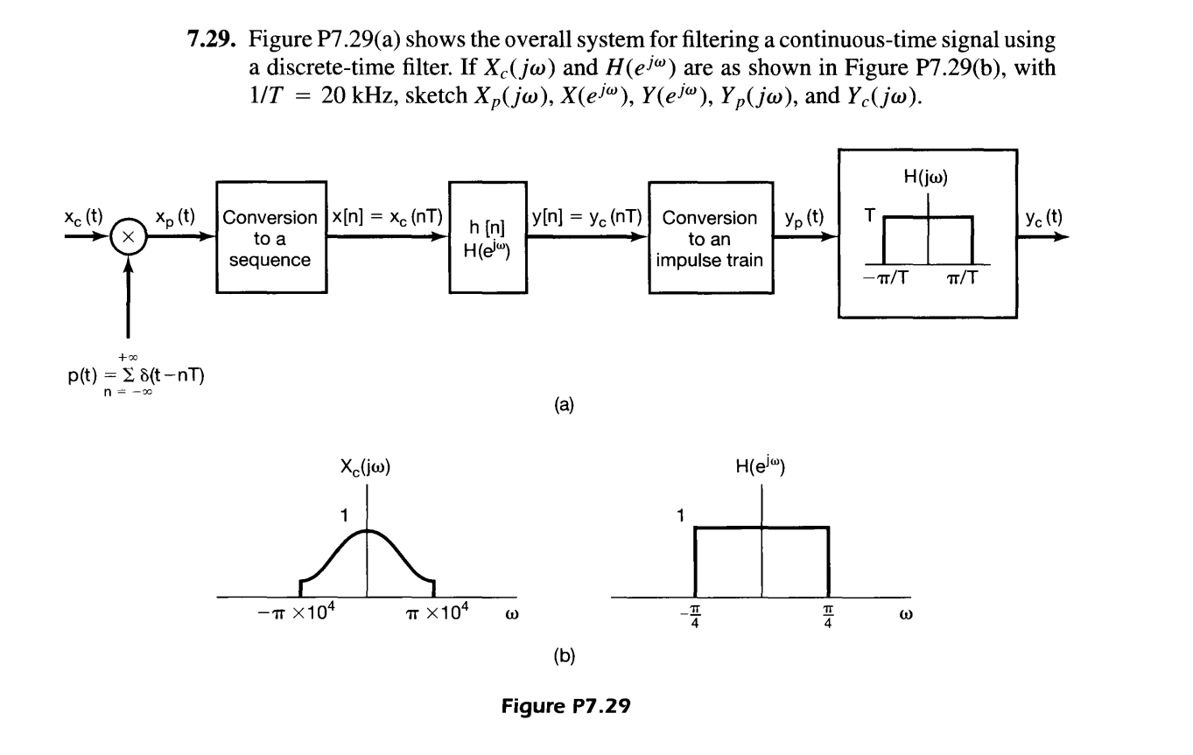
Exercise 1

Slide 10
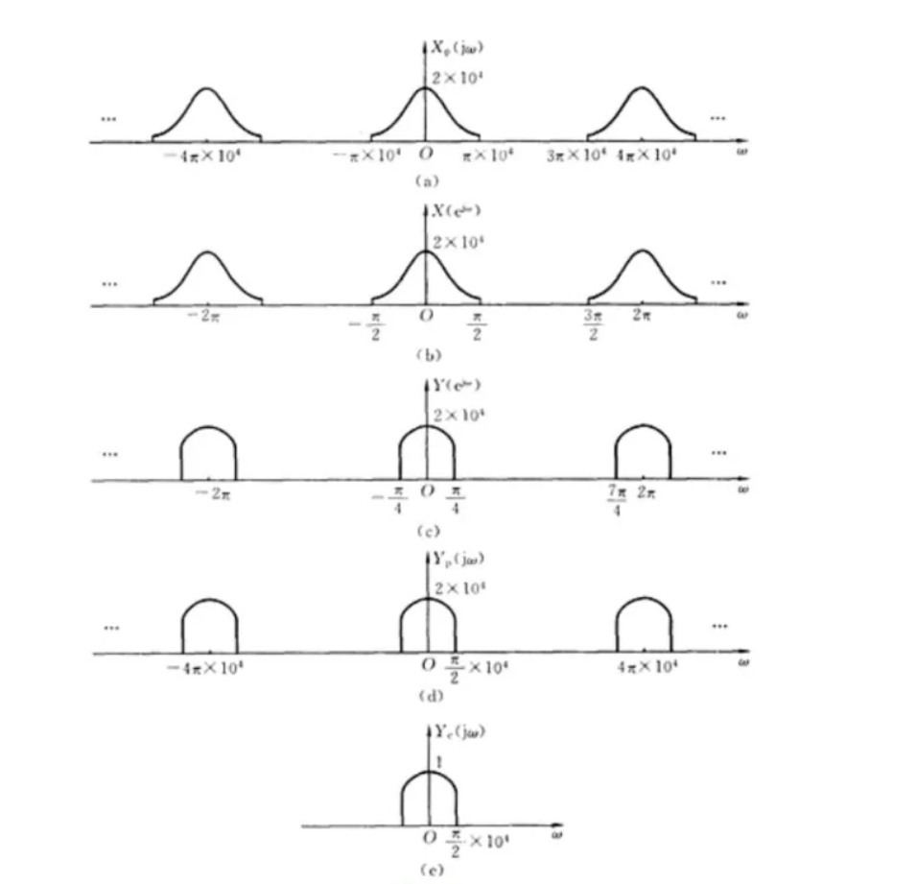
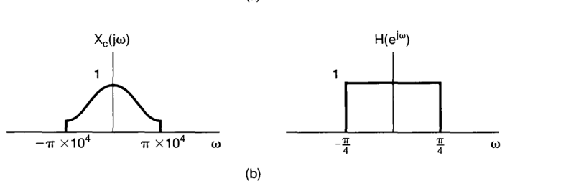
Solution

Slide 11
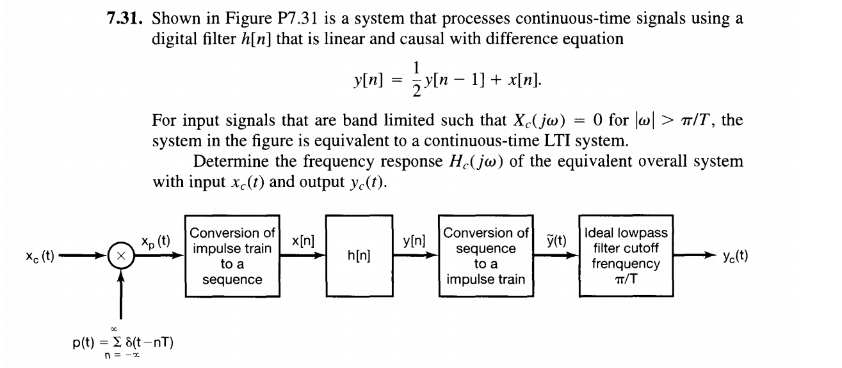
Exercise 2

Slide 12
Solution
Sampling / CD converter
DC converter
Ideal lowpass filter

Slide 13
End

